Slide 1
D Palumbo (Agenda Item 15d) “Emails Received” Comparisons – Noise – Parking – Shark Fishing
June 1, 2026

Slide 2
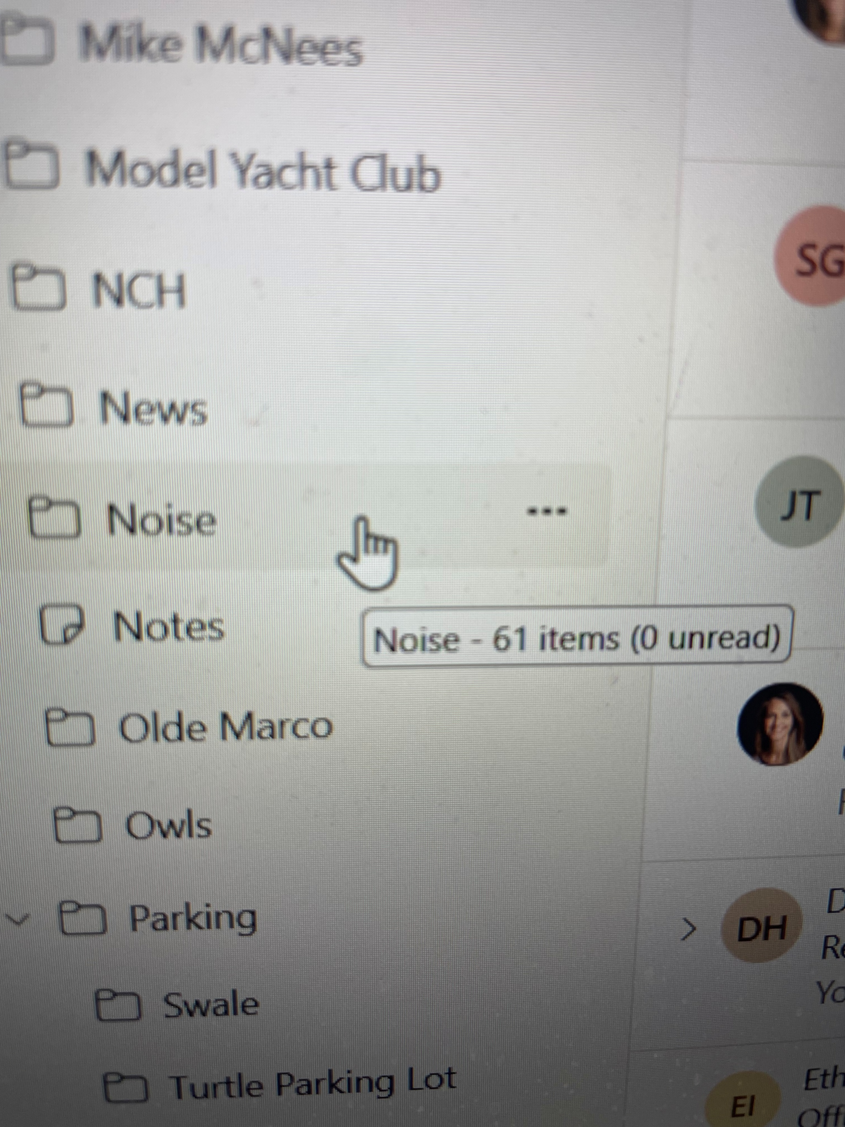
Chair Palumbo’s Email Count – Slide 1.

Slide 3
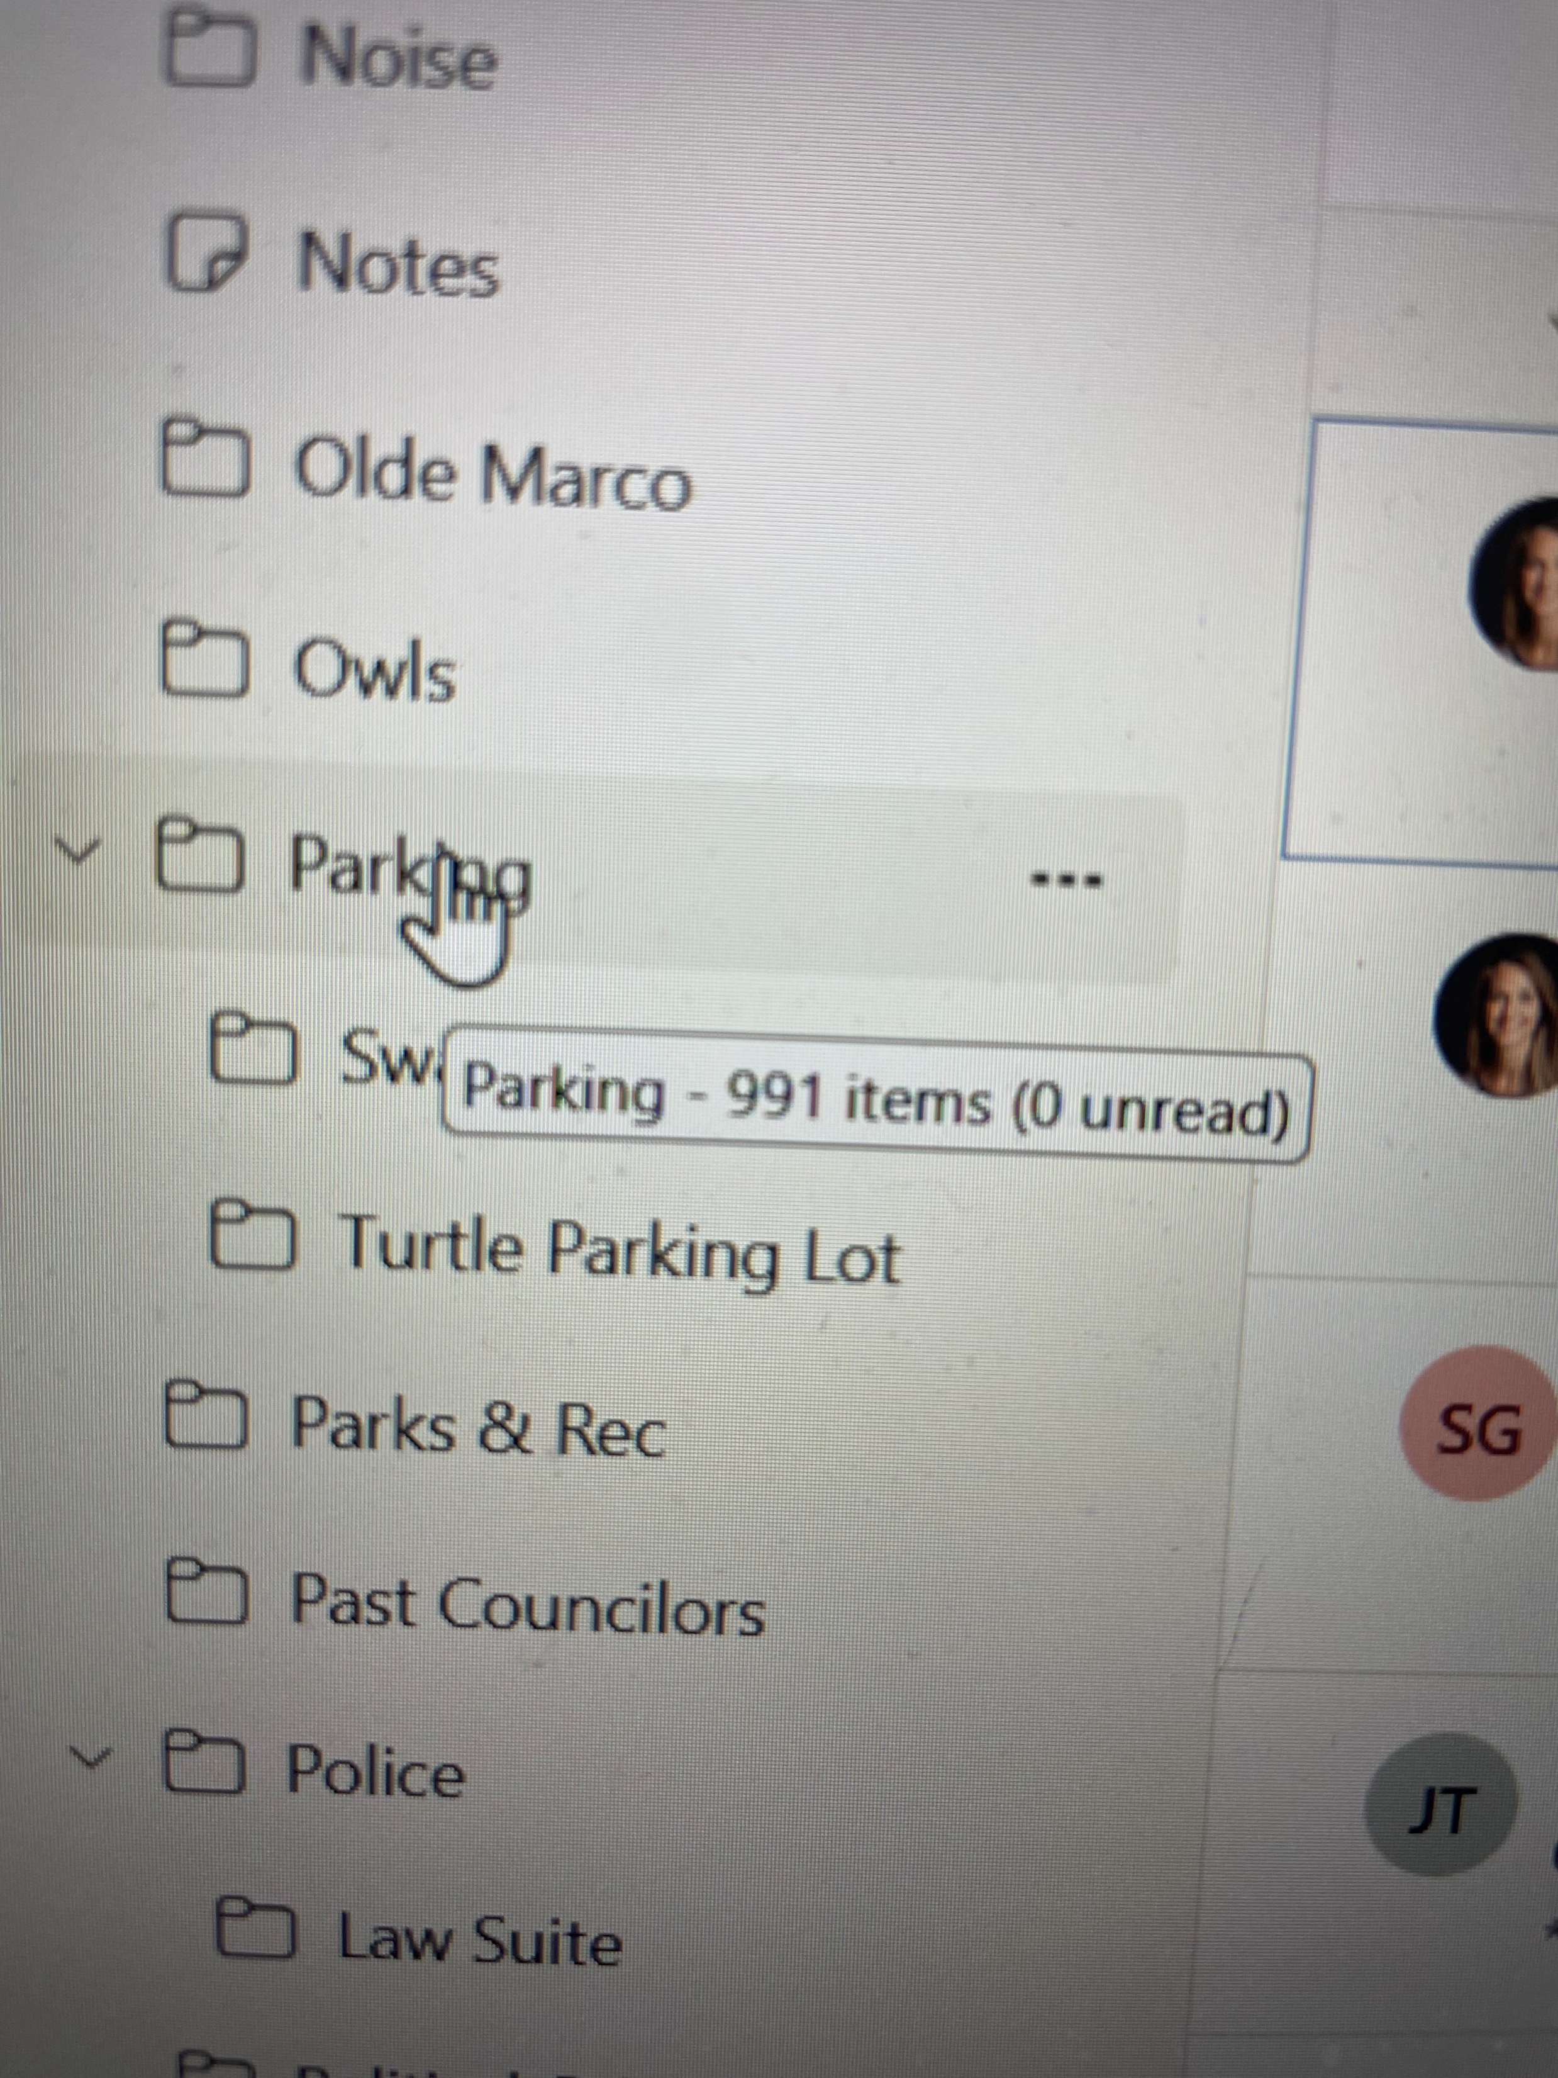
Chair Palumbo’s Email Count – Slide 2.

Slide 4
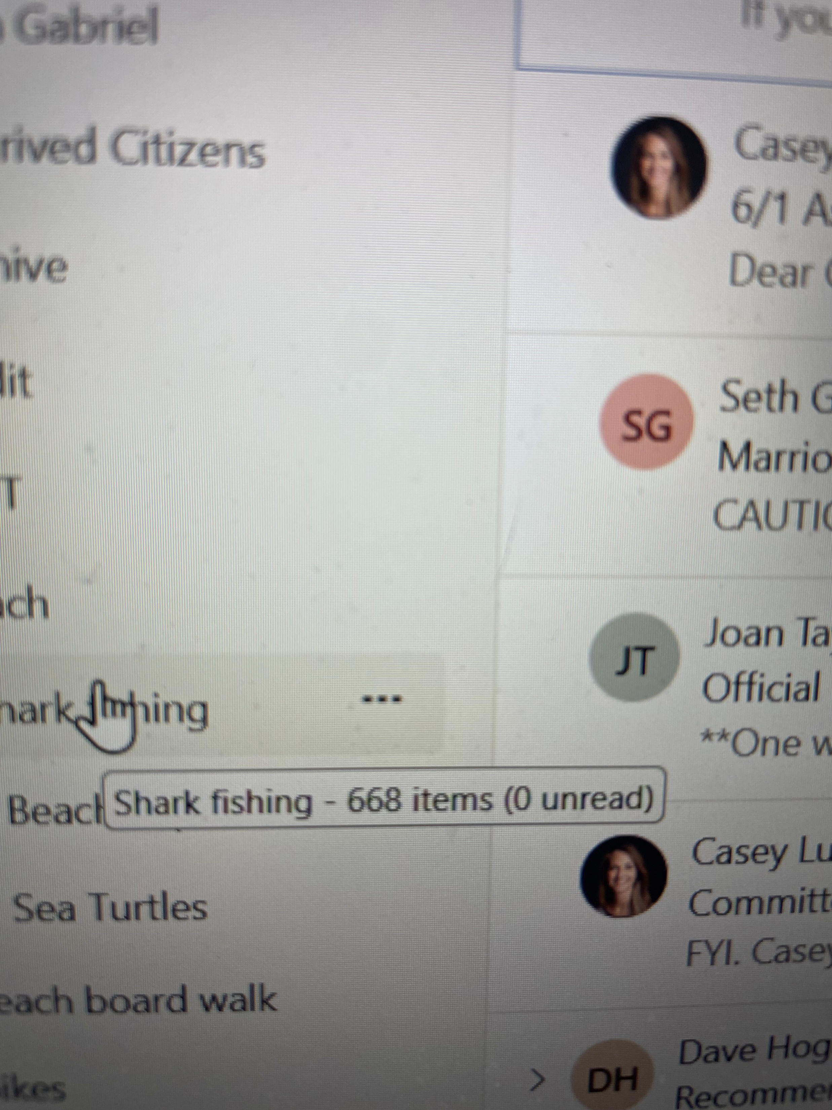
Chair Palumbo’s Email Count – Slide 3.

