Slide 1

SDPA-25-000179
VP-26-000054
Collier County Public Utilities
2559 San Marco Road
Marco Island, FL 34145

Slide 2
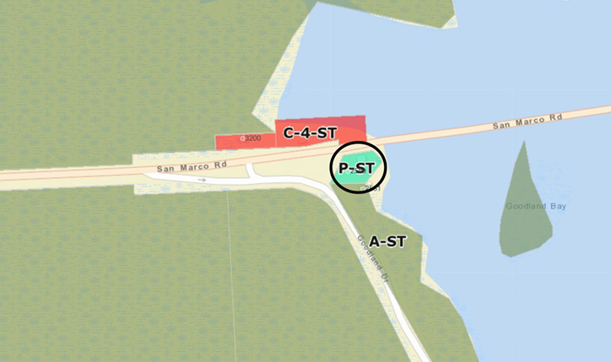
Map of Site with Current Zoning Classification Noted

Slide 3
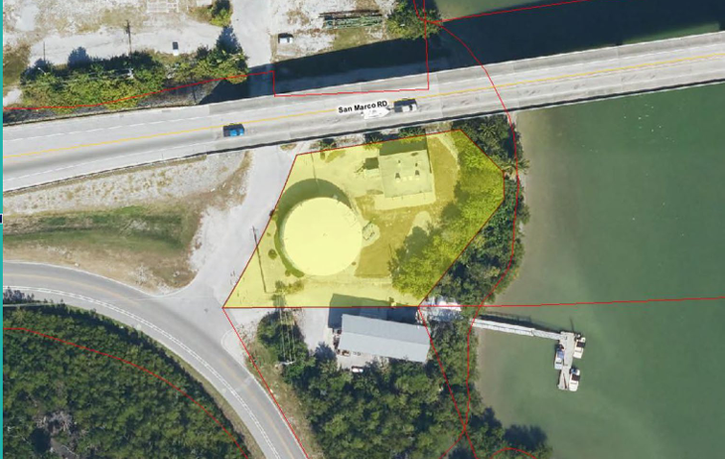
Overhead View of Site with Yellow Highlighting of Property Boundaries

Slide 4
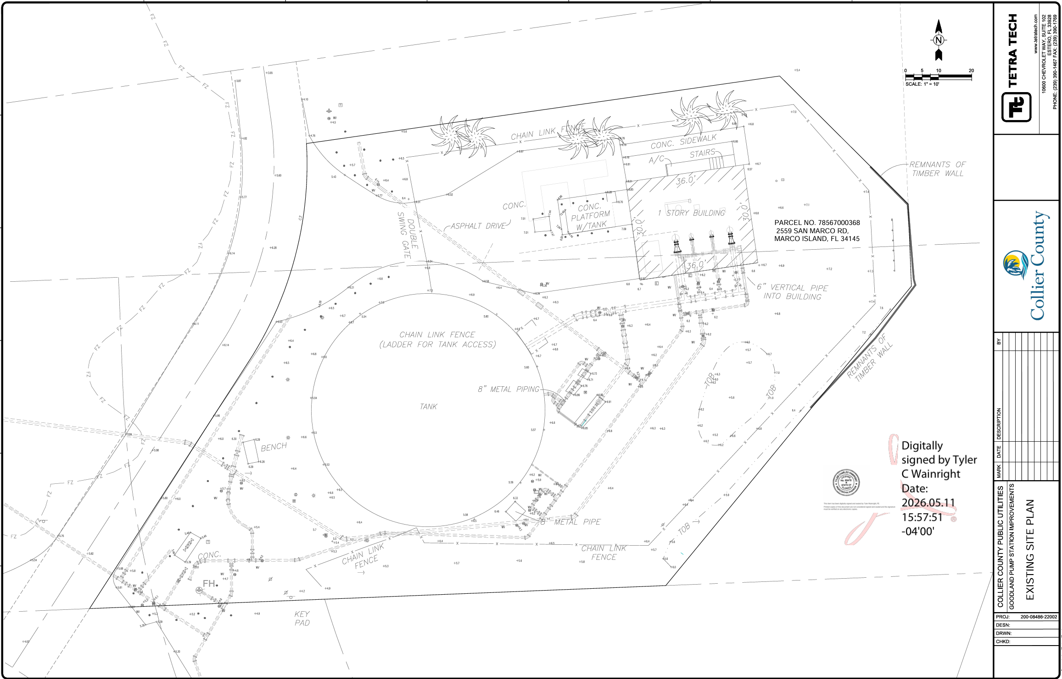
Collier County Site Plan Survey of Goodland Pump Station
Existing Site

Slide 5
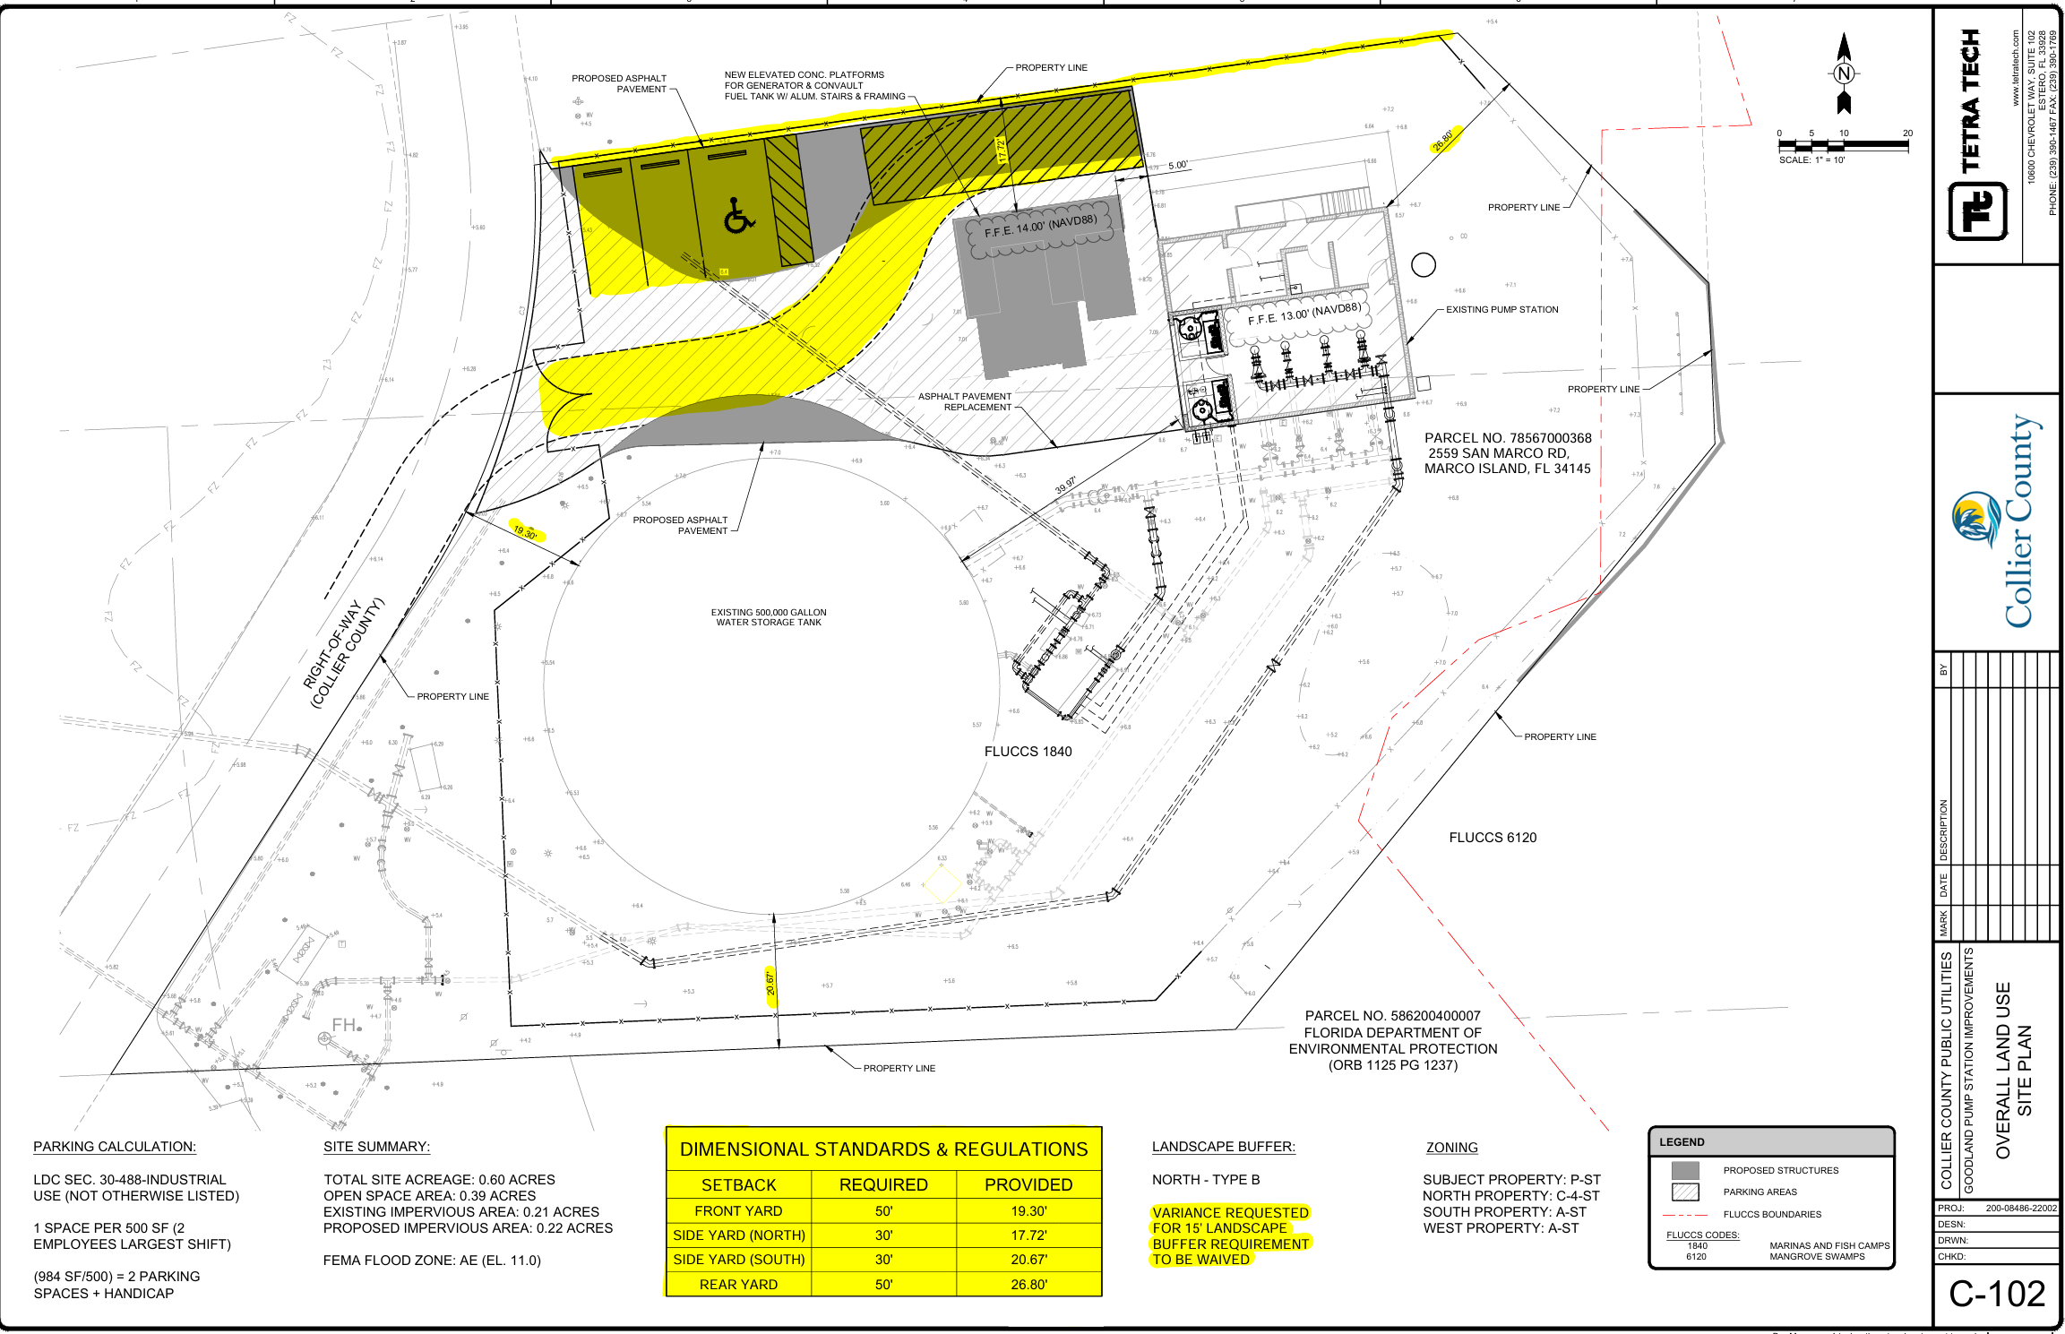
Collier County Site Plan Survey of Goodland Pump Station with Highlighting of Variance Locations
Proposed

Slide 6
Staff Recommendation Summary
Staff Recommendation:
Staff is recommending the Planning Board approve SDPA-25-000179 with the conditions outlined in the Staff report and forward a recommendation of approval for VP-26-000054 the findings and conditions out lined in the Staff report.

